Slide 1

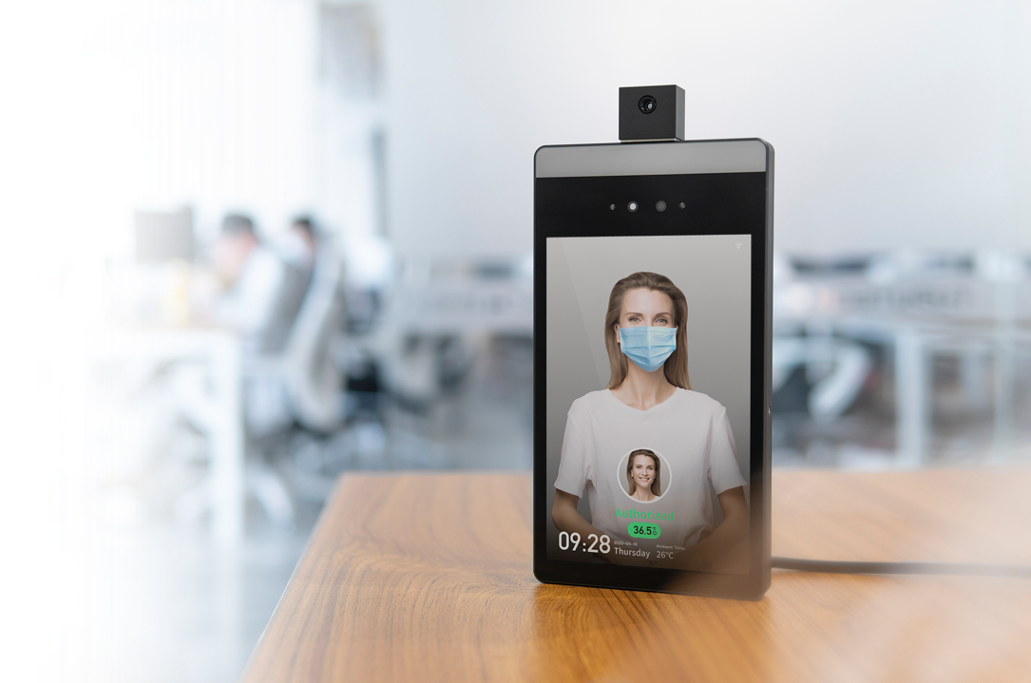
TupuCheck
Face Recognition & Thermometric
Access Control Terminal
DATASHEET
Features
Touchless Access Control · Infrared thermography · Temperature detection · Fever alarm & notification Mask detection& mask wearing reminder · Offline Recognition · Delicate design
Highlights
Multilingual System: support Chinese, English, Italian, Spanish, French, Polish and Lithuanian
Recognition in Milliseconds: world-leading TUPUTECH® algorithms to provide verify speed less than 0.1s for facial recognition and 100ms for temperature measurement per person.
Temperature Calibration Powered by AI Algorithm ( no need of black body): exclusive AI algorithm propelling temperature calibration against distance and environmental effect, attaining higher accuracy without black body.
Different modes for different scenes: different modes for: 1) for temperature measurement only; 2) access control authorization based on identity authentication and body temperature measurement; 3) temperature measurement supported, but access control authorization based on identity authentication only
Detection of Different Types of Masks: masked face temperature measurement and mask wearing reminder based on detection of different types of masks including N95 mask, pure color regular mask, patterned mask, surgical masks, etc..
Support different types of installation: compatible with existing access control infrastructure (automatic door, metal detector door, turnstile, standalone, etc.) with different brackets and stands.
Different Data Storage Solutions: work with Tupu Face Access cloud platform on default. Provides data storage solution based on Amazon Web Services.

Slide 2
Specifications
CAMERA
Stereo Camera | 2.0 Megapixel (RGB)+2.0 Megapixel (IR)
Illumination | White light & IR fill light; red & green light Indicator
FACIAL RECOGNITION
Log Capacity | 100000
User Capacity | 10000+
Anti-Spoofing | Yes
Mask Detection | Yes
Masked Face Recognition | Yes
Mask Wearing Reminder | Yes
Recognition Speed | <0.1s
FAR | <0.1%
Accuracy | 99.90%
Authentication Mode | 1:N face matching
BODY TEMPERATURE MEASUREMENT
Measuring Range | 25-45℃（77-113℉）
Measurement Accuracy | ±0.3℃（±0.54℉）
Measuring Distance | ≤1m
GENERAL
Operating System | Android
Language | English, Italian, Spanish, Polish, Chinese
Display | 8-inch full view IPS LCD
Power | DC 12V-2A
Audio Prompt | Yes
Operating Temperature/Humidity | Temperature: 0-60℃ Humidity: 10%～90%
Wireless Connectivity | Wi-Fi 802.11 a/b/g/n (2.4/5GHz)
Storage | 8GB
Interface | Wiegand26 x1; USB2.0 OTGx1; Access control interface x1; RJ45(10/100M Ethernet interface) x1；DC5.5mm*2.5mm
Installation | Wall-mounted/turnstile-mounted/stand bracket
Accessories (optional) | Wall mount bracket/turnstile-mounted bracket/floor stand/desktop bracket/rain cover

Slide 3
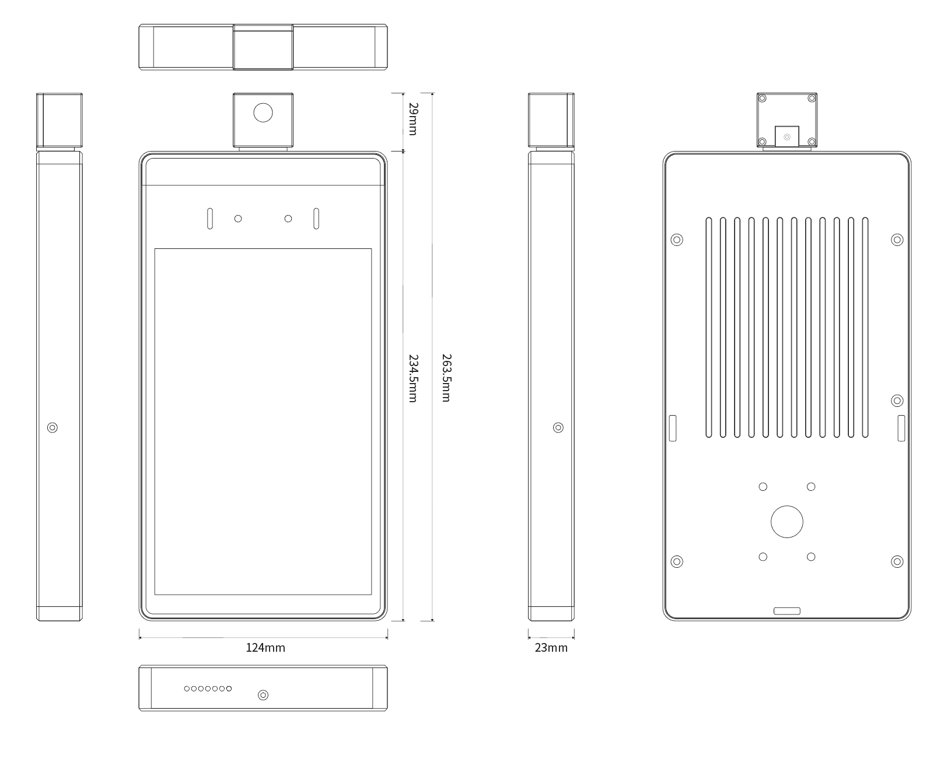
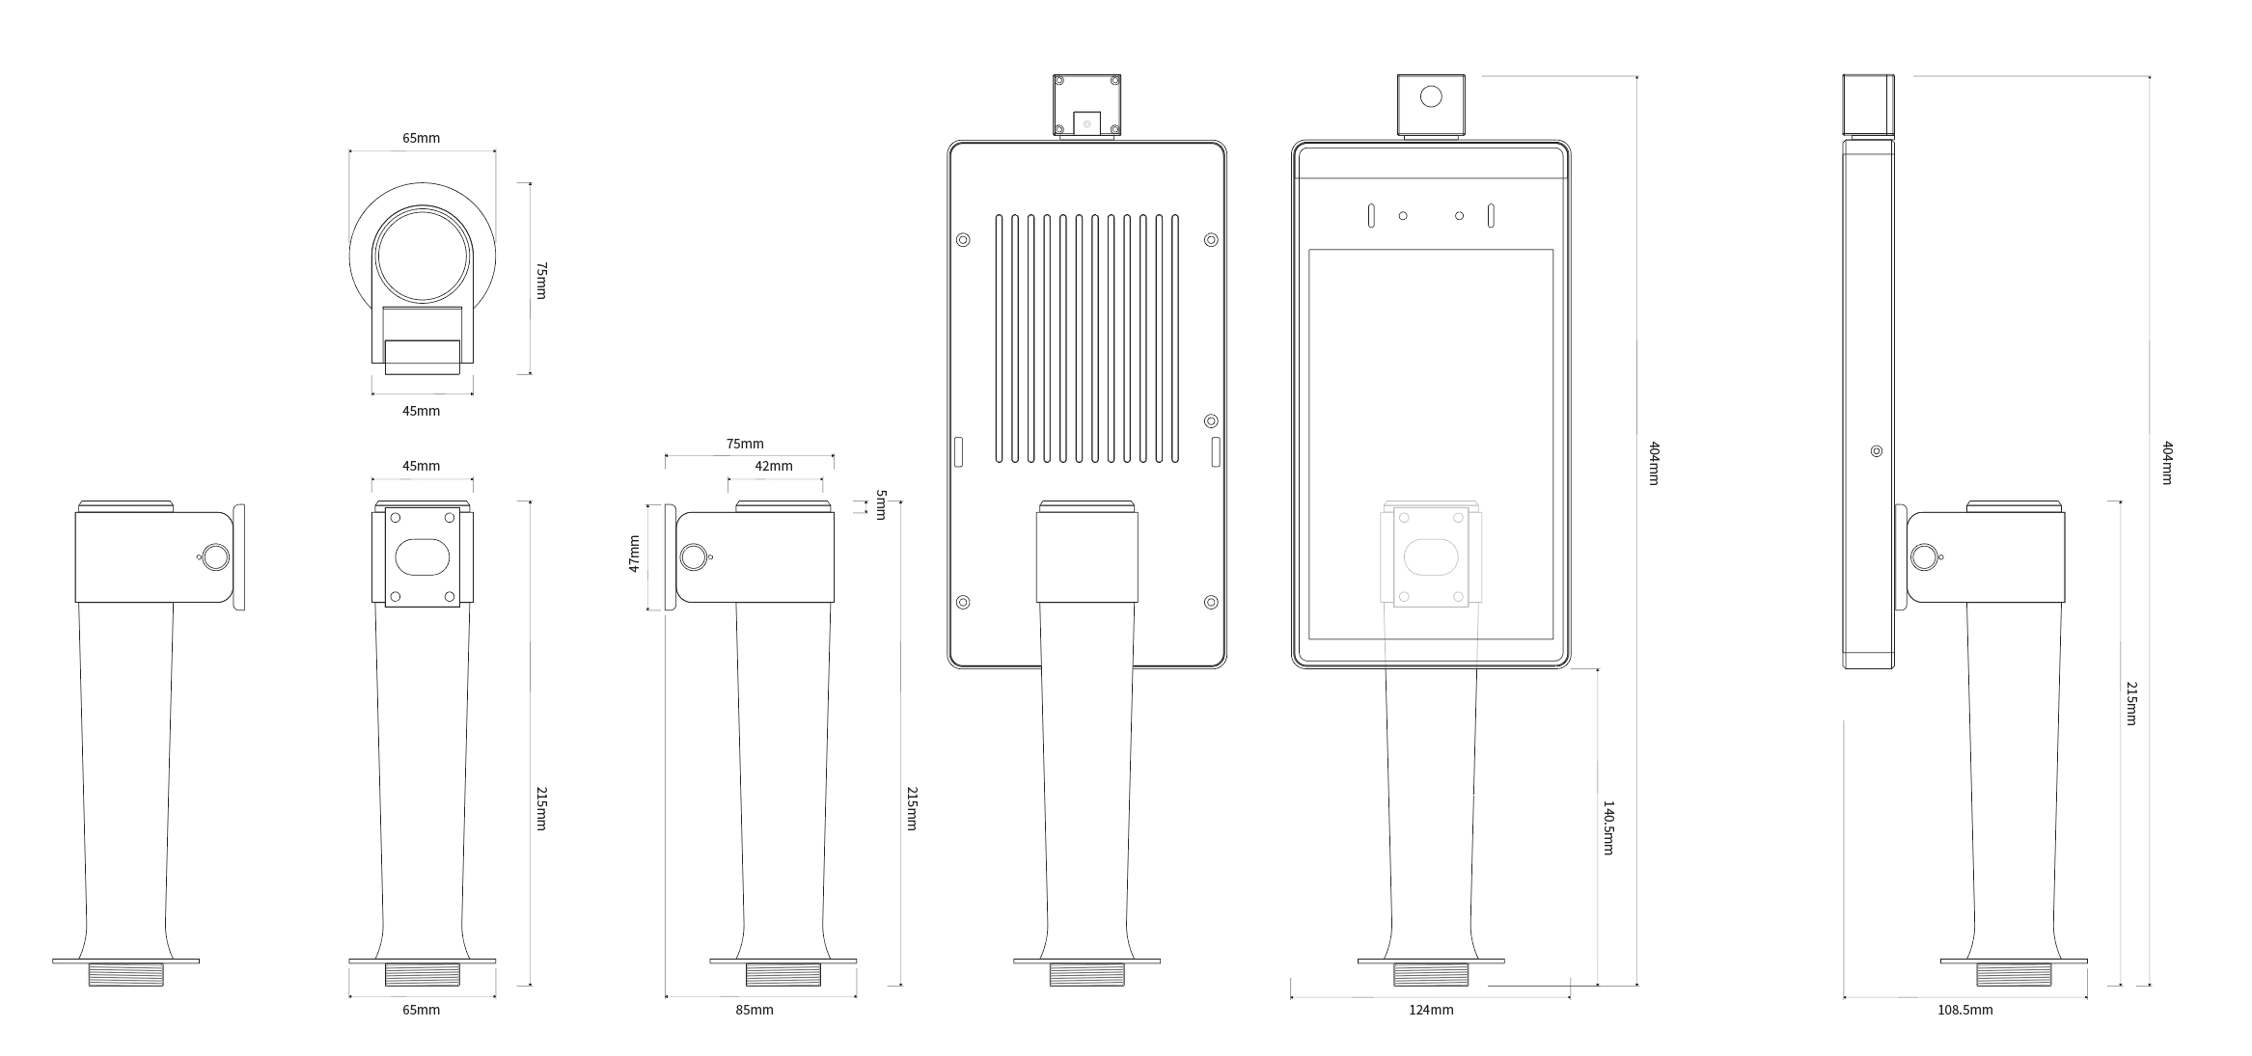
Dimensions
TupuCheck Terminal
Dimension | 263.5x124x23mm | Weight | 0.8kg
TupuCheck Pro with turnstile-mounting bracket
Dimension | 404x124x108.5mm | Weight | 1.3kg

Slide 4
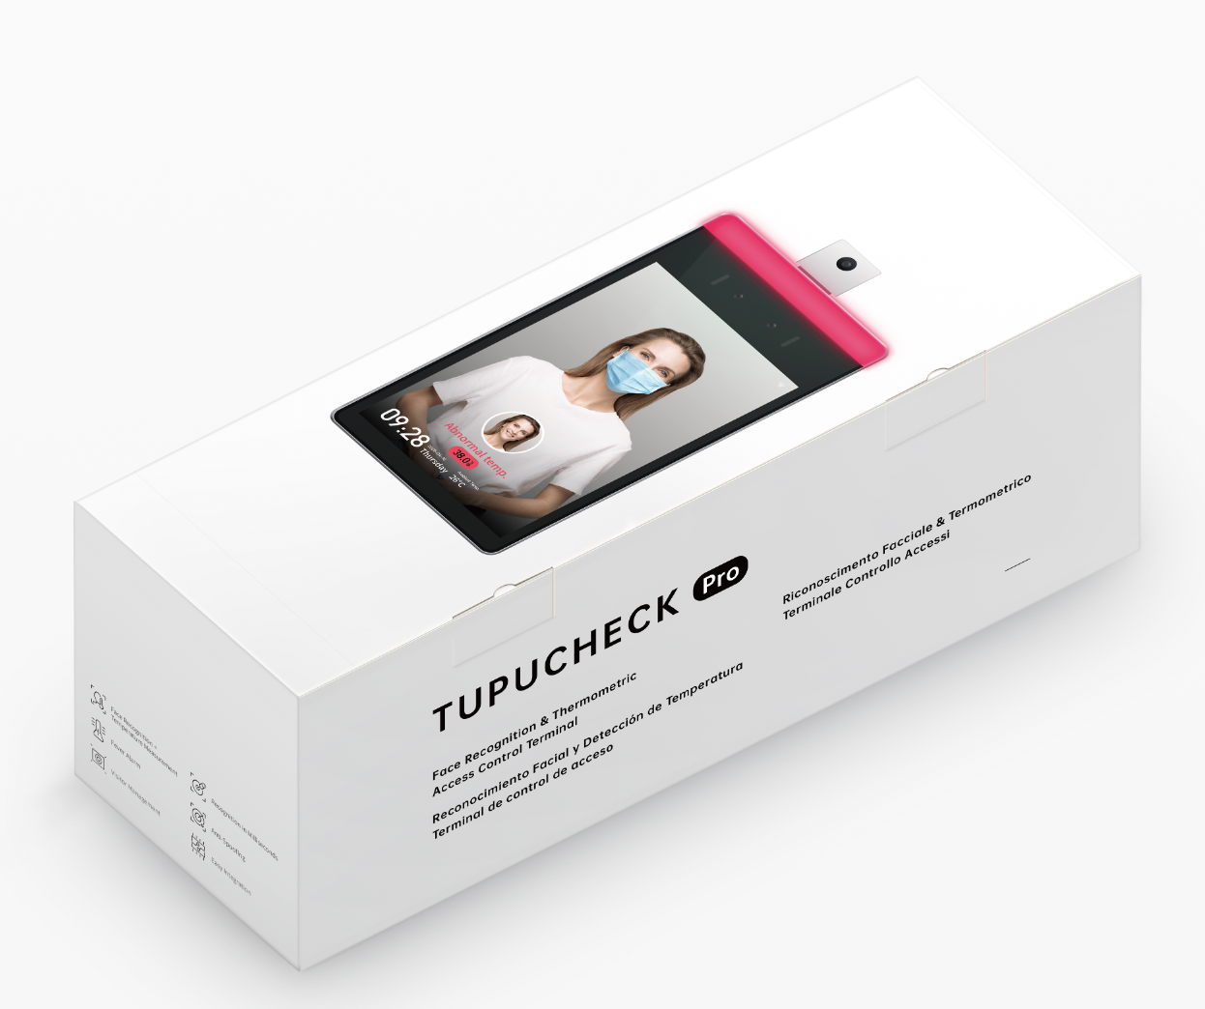
Packing
Packing Type: carton box
Dimension: 446mm(L) * 166mm(W) * 141mm(H)
Packing list:
TupuCheck Terminal Device x 1
Power adaptor x 1
Wall mounting bracket (optional) x 1
Turnstile mounting bracket (optional) x 1

Slide 5
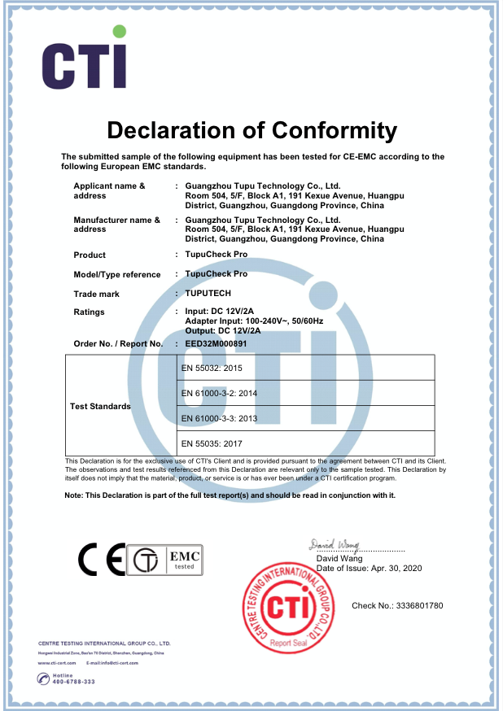
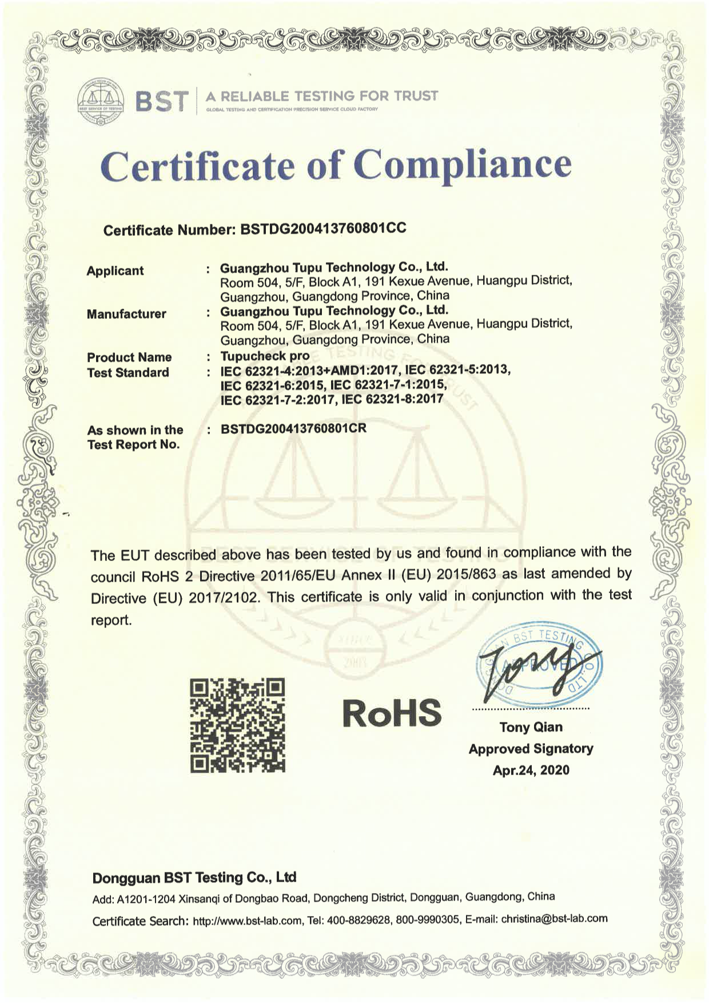
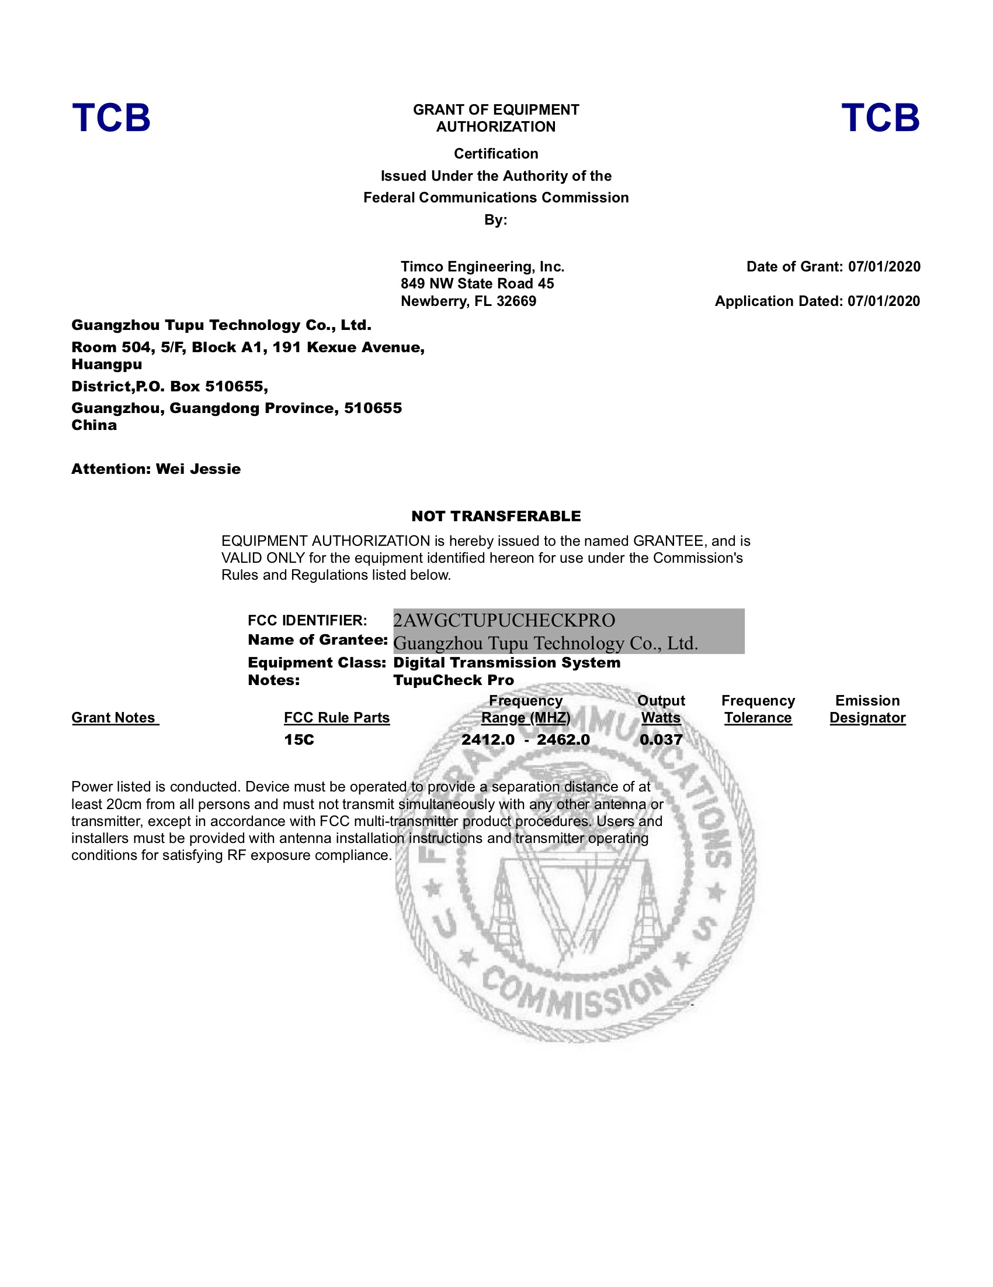
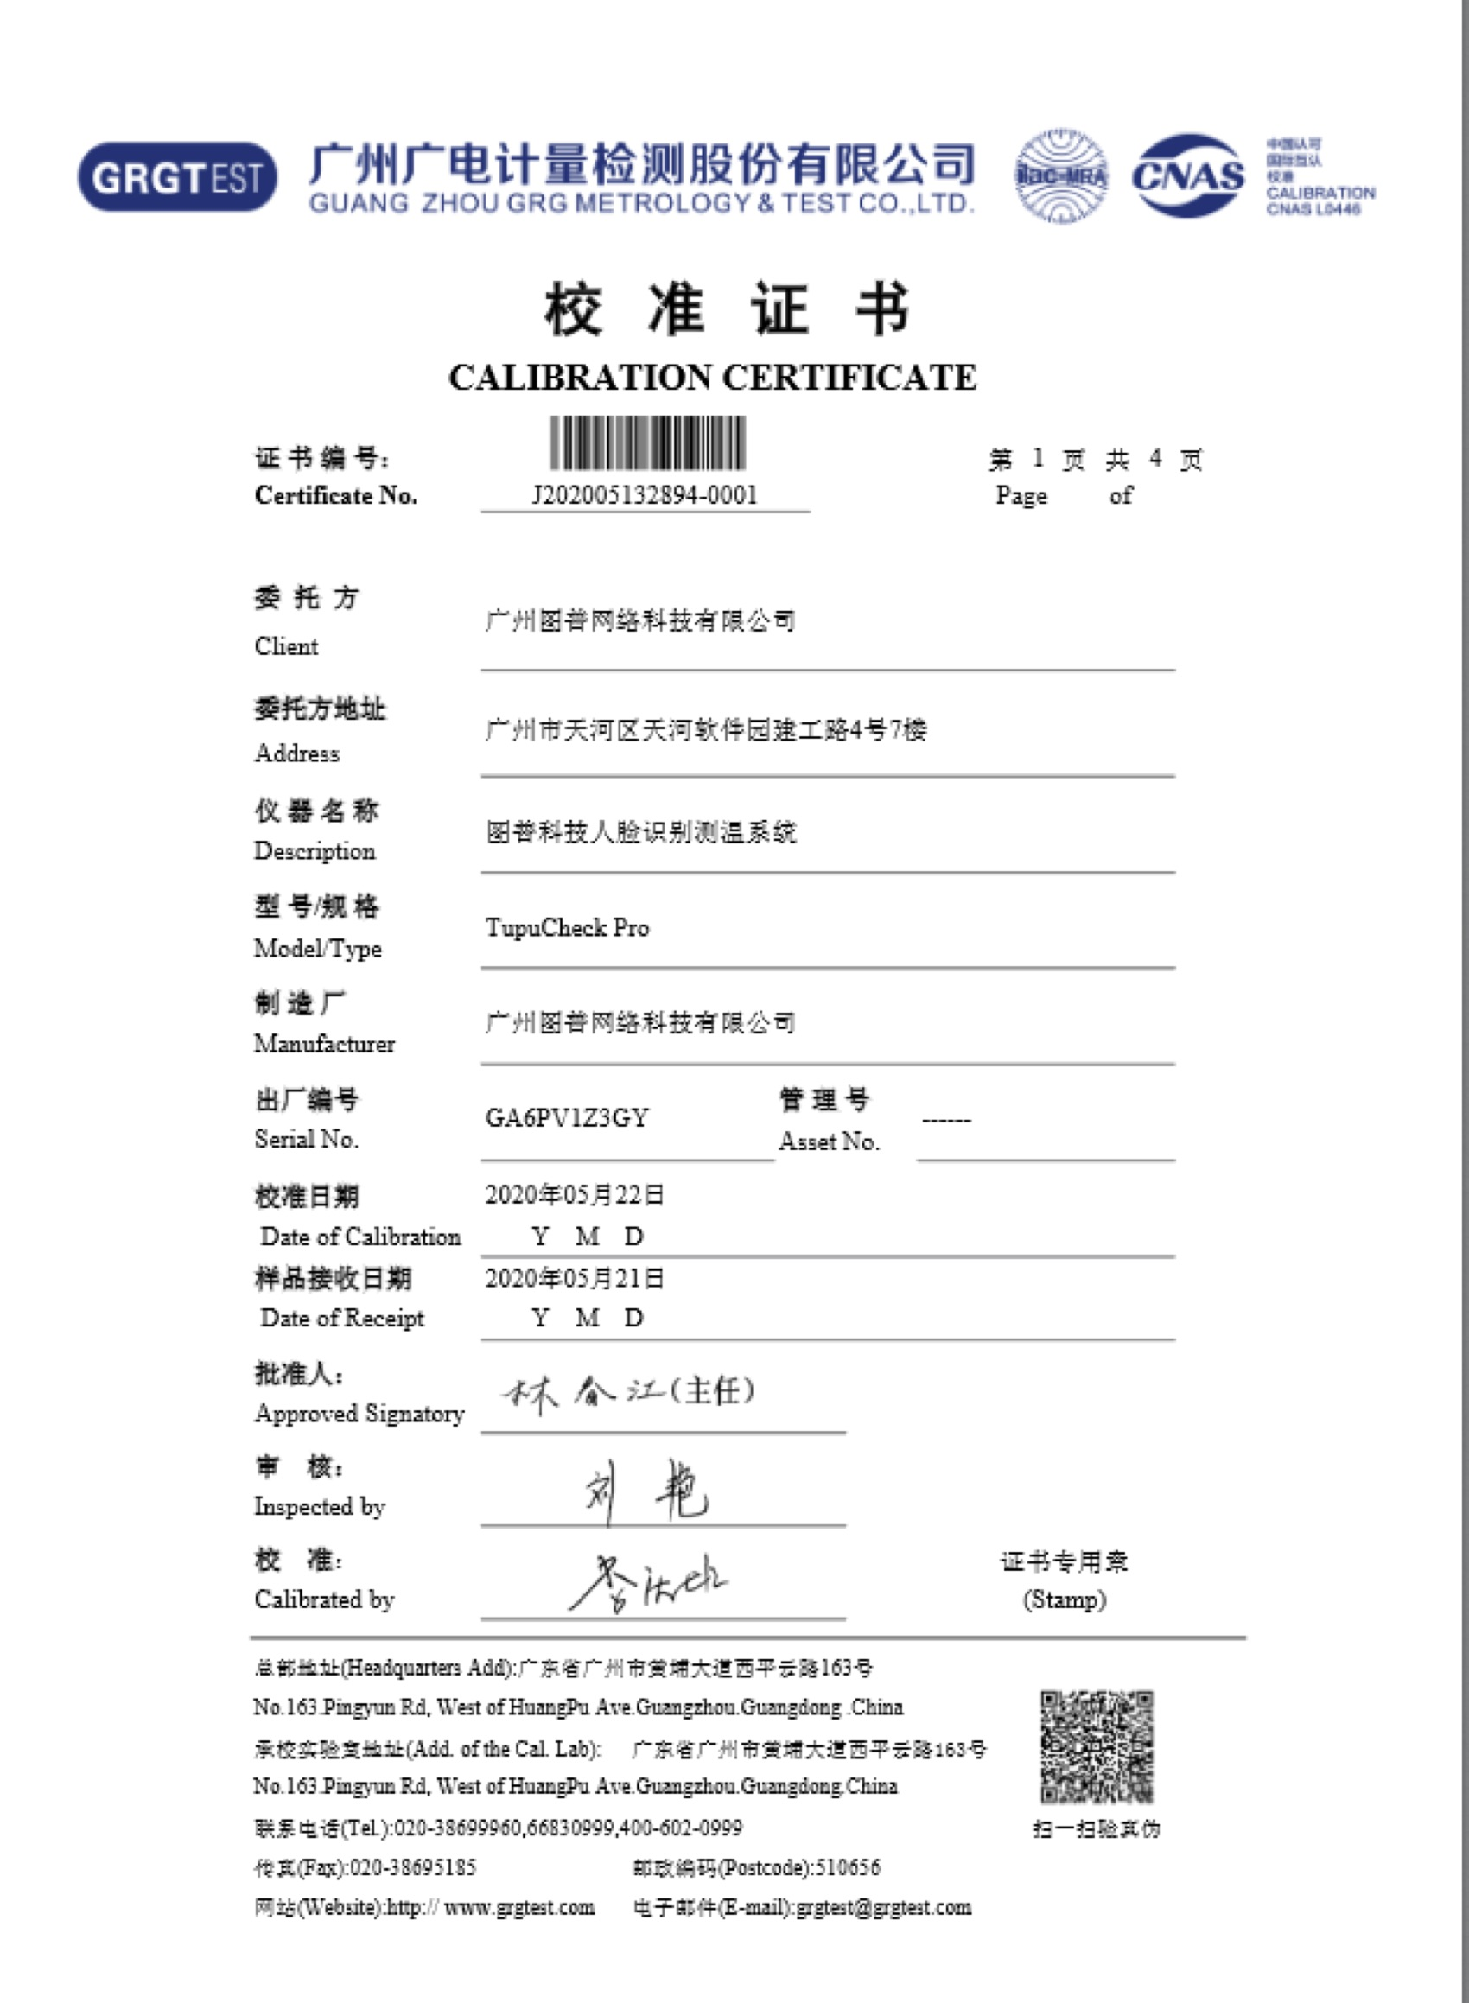
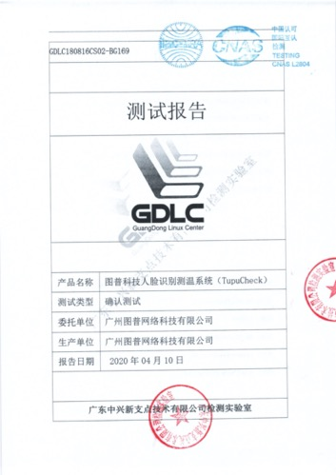





Certification
CE
RoHS
FCC
Calibration Certificate
CNAS
AI for a Smarter World
https://us.tuputech.com
sales@tuputech.com
Guangzhou City, China
+86-18028524307

